Slide 1
VIRTUAL Try-On Dressing Room

Slide 2
Project Description:
Buying apparel through e-commerce has certain limitation of trying apparel before buying it.
Provide a virtual room to try apparel through e-commerce website before buying it.
So that users are motivated to buy online apparel through e-commerce website and lesser chances of returning and cancelling of apparel because of having a facilities to try apparel through a virtual room.
we were included many things like goggles , t-shirts, ear rings , tiaras , frocks , etc.…

Slide 3
01.
Development Environment

Slide 4
Development environment
Software Requirement:
Cmake (3.12.0)
Dlib (19.15.0)
Opencv (3.4.2.17)
Scipy (1.0.0)
Cascade trainer gui (1.8.0)
Tkinter canvas (8.6.8)
Numpy (1.18.1)
Anaconda (4.8.2)
Python (3.7.4)
Flask Web framework (1.1.1)

Slide 5
Development environment
Hardware Requirement:
For this project we need high configurations system because such tasks in this project requires more CPU computation and high graphic support to train haar cascade dataset and for more accuracy we need to increase number of EPOCH in training of convolutional neural network.
Once the dataset and network models are trained then we can run python code on normal machine also.

Slide 6
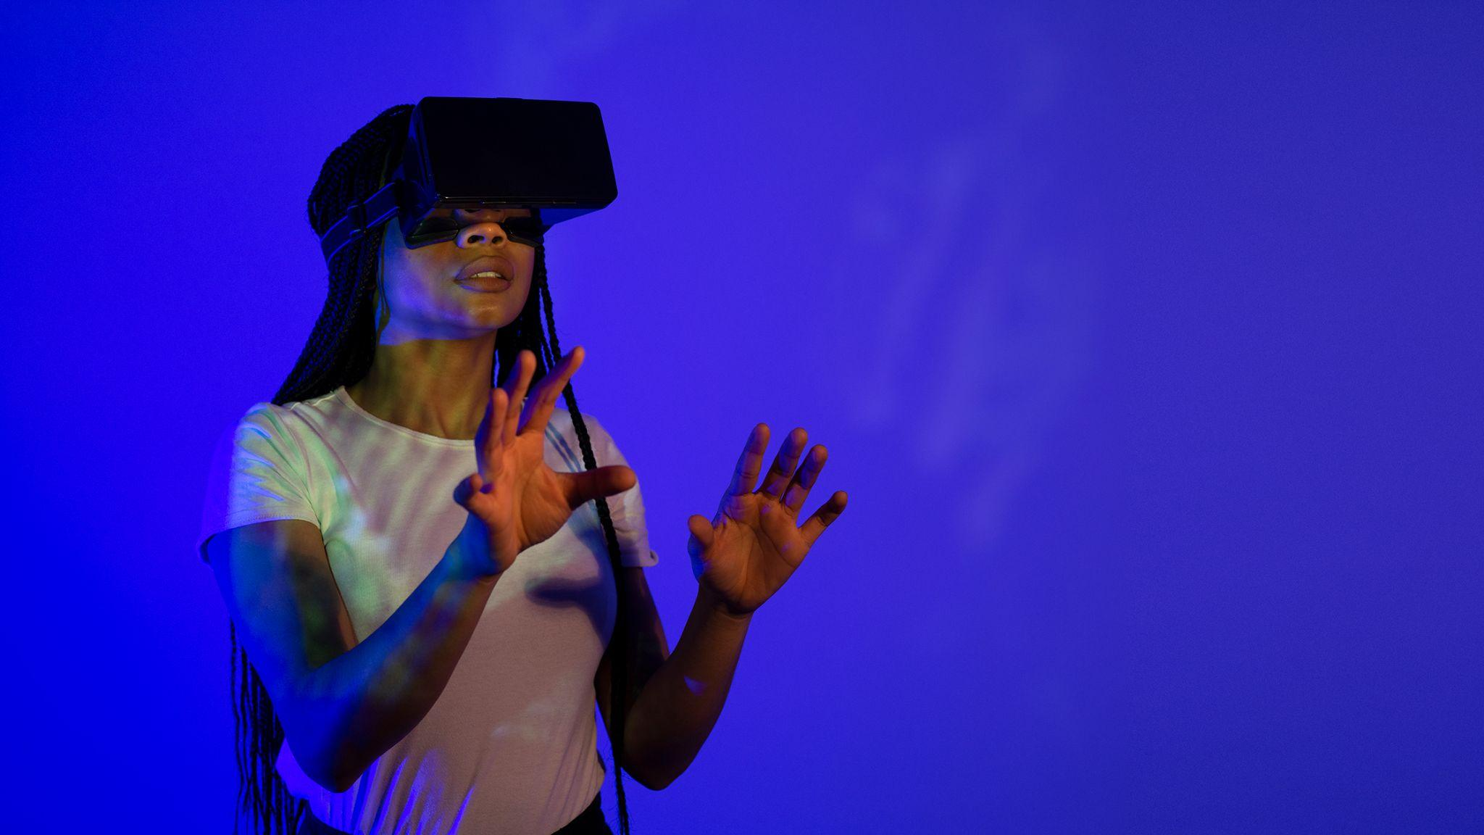
Major Features
Venus has a beautiful name and is the second planet from the Sun. It’s terribly hot, even hotter than Mercury

Slide 7
Major Features:
First of all for we need to detect body parts of target human body and we need to transfer things according to suitable body parts.
So for body part detection we were used haar cascade dataset.
So what is haar cascade dataset ?
24 * 24 target window is moving on to the image and it contains features like(line features,rectenguler feature,edge feature etc..)
value of feature is computed using concept of integral images(it would select best value of featuure among this by using adaboost classifier)
They are like convolutional kernels. haar features are relavent feature for object detection and non-relevant features are discarded by adaboost algorithm.

Slide 8
Major Features:
How to train haar cascade dataset ?
Opencv provides some pre trained haar cascade and for creating your own haar cascade there are three methods are available.
File provided by Auckland university to create haar cascade using command prompt but it is very tedious process and not that much of accurate(training time is more).
Method provided by youtuber sendex but actually it does not uses windows to create haar cascade it uses aws ($5/month).
Amin ahemadi gui creater for creating haar cascade (cascade trainer gui).

Slide 9
Major Features:
How to train haar cascade dataset ?
Opencv provides some pre trained haar cascade and for creating your own haar cascade there are three methods are available.
File provided by Auckland university to create haar cascade using command prompt but it is very tedious process and not that much of accurate(training time is more).
Method provided by youtuber sendex but actually it does not uses windows to create haar cascade it uses aws ($5/month).
Amin ahemadi gui creater for creating haar cascade (cascade trainer gui).

Slide 10
Major Features:
Process of training haar cascade:
Haar feature(white black boxes moving on to the image and extract the feature.)
Integrall images approach(to make fasten the process of computation of data)
Adaboost classifier (extract best feature and discarding non-relevant feature)

Slide 11
Major Features:
We were used flask micro framework as a interface between backend(python) and front end(html).And for gui we used tkinter library which was written in python for design user interface.
@app.route("/") it means whenever the home page is found involk the function below it under that function in the end of that function you are returning a function render_template("html file") and whatever html file is given in the argument that html page will be shown in the browser for that this html file should be available in template folder
@app.route("/success",methods=["POST"]
it means whenever the route is scuccess then involk the function below it post shows that we are sending data to server

Slide 12
Future Enhancement:
After detecting body parts of target image there are certain operation we need to perform for make this accurate.
So for this we need to train three type of network through which we can set clothes on target image.
PAN (pose alignment network)
TRN (texture refinement network)
FTN (fitting network)

Slide 13
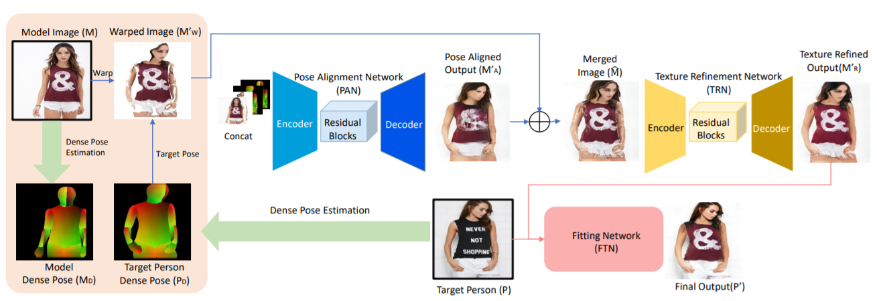
Graphical Representation:

Slide 14
References:
M2E-Try On Net: Fashion from Model to Everyone(https://arxiv.org/pdf/1811.08599v1.pdf)
VITON: An Image-based Virtual Try-on Network(https://arxiv.org/pdf/1711.08447.pdf)

